Slide 1
Profiling QML
Stanley Morris / OC Qt/QML Meetup

Slide 2
Agenda
Causes of performance issues
Demo of QML Profiler
Running on Embedded Platforms
Environment Variables

Slide 3
Causes of performance issues
JavaScript handlers > 16ms
look for gaps in timeline
Drawing hidden Items
Use QSG_VISUALIZE=overdraw
Long running C++ operations
Not visible in QML Profiler

Slide 4
To Profile on Embedded Device
https://wiki.qt.io/How_To_Profile_QML_App_on_Embedded_Device
Device needs Qt build at same location specified in configure “prefix”. “-prefix /usr/local/qt-48x-emb” contents must be found at target’s “/usr/local/qt-48x-emb” folder.
App must use same toolchain as Qt build.
More requirements on wiki page...

Slide 5
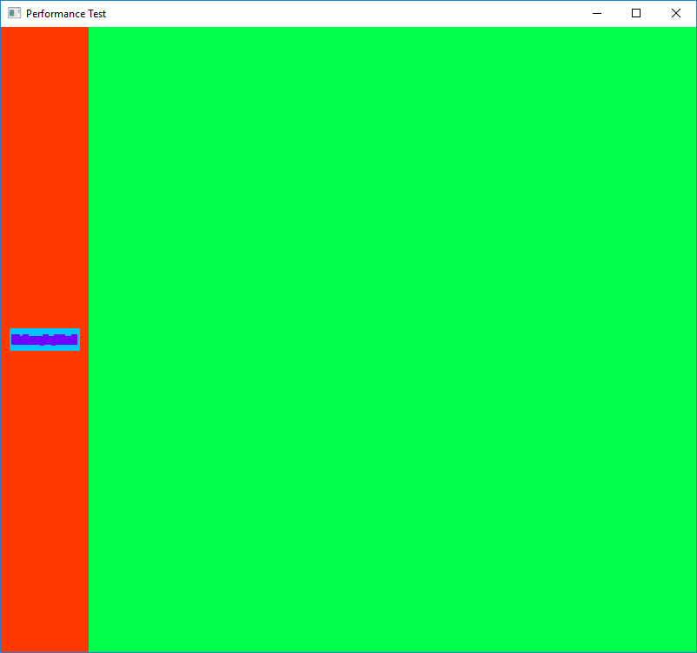
Environment Variables: QSG_VISUALIZE=batches
http://doc.qt.io/qt-5/qtquick-visualcanvas-scenegraph-renderer.html#visualizing-batches
Merged batches are drawn in a solid color.
Fewer colors is better
Unmerged batches are drawn with diagonal lines
Bad if they contain many individual nodes

Slide 6
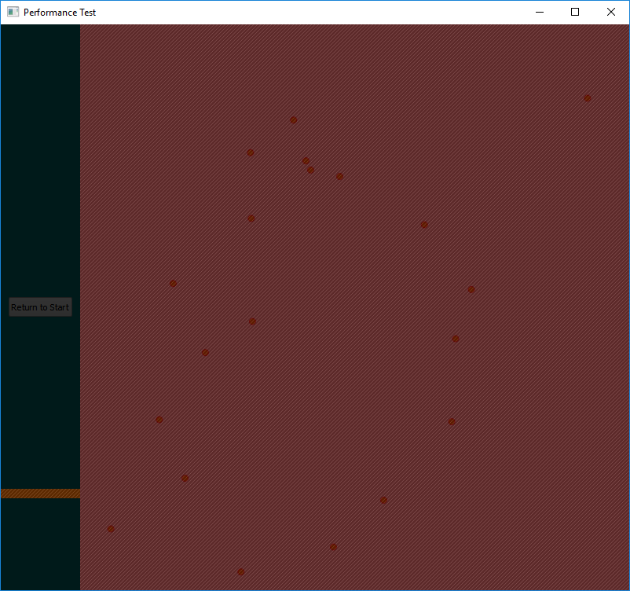
Environment Variables: QSG_VISUALIZE=clip
http://doc.qt.io/qt-5/qtquick-visualcanvas-scenegraph-renderer.html#visualizing-clipping
Red areas indicate clipping.

Slide 7
Environment Variables: QSG_VISUALIZE=changes
http://doc.qt.io/qt-5/qtquick-visualcanvas-scenegraph-renderer.html#visualizing-changes
Changes are visualized with a flash of color
Do not use if you haven’t taken your epilepsy medicine!

Slide 8
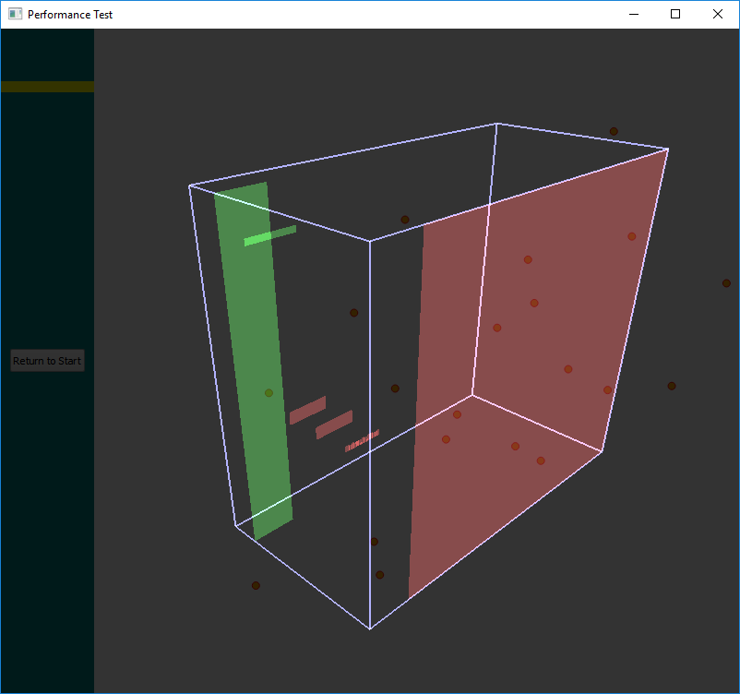
Environment Variables: QSG_VISUALIZE=overdraw
http://doc.qt.io/qt-5/qtquick-visualcanvas-scenegraph-renderer.html#visualizing-overdraw
Renders in 3D to identify overdrawn items.

Slide 9
Environment Variables: QSG_RENDER_TIMING=1
http://doc.qt.io/qtcreator/creator-qml-performance-monitor.html#analyzing-scene-graph-events
Detailed information on scene graph events

Slide 10
Environment Variables: QSG_RENDERER_DEBUG=render
http://doc.qt.io/qt-5/qtquick-visualcanvas-scenegraph-renderer.html#performance
Statistics on how well the batching goes
How many batches
Which batches are retained
Which are opaque and not
Best performance with less than 10 batched and at least 3-4 of them opaque.

Slide 11
Resources
Ulf Hermann’s QtDD14 QML Profile Presentation
https://www.youtube.com/watch?v=TiJiF0MOOFc&feature=youtu.be
Qt Profiling QML Applications Documentation
http://doc.qt.io/qtcreator/creator-qml-performance-monitor.html

